Slide 1
NUTRITION AND DEVELOPMENT
John Hoddinott, Cornell University
September 16, 2015
PRESENTATION FOR CIIFAD SEMINAR SERIES:
PERSPECTIVES IN INTERNATIONAL DEVELOPMENT

Slide 2
Overview
A story in three parts:
Sorting out some preliminary ideas
The conventional view: From economic development to better nutrition
A different view: From better nutrition to economic development

Slide 3
Some preliminaries
Elements of development:
  Higher levels of income / consumption
  Better health
  More schooling
  Improved access to public services
  A clean and safe environment
  Greater sense of agency and choice
Elements of nutrition:
  Food and diet (quantity and quality)
  Measures of nutritional status such as body measurement (heights and weights), biomarkers of micronutrient status (Vitamin A, iron etc)

Slide 4
From development to better nutrition

Slide 5
Conventional thinking: From development to better nutrition
Examples
Food consumption (quantity and quality) is a function of incomes (possibly differentiated by sex), prices and market access all mediated by preferences
Nutritional status of children reflects food intake (quantity and quality) and health status. In turn, these reflect resources (income, possibly differentiated by sex), child care practices (influenced by care giver levels of schooling) and access to and use of health services and a safe and hygienic environment

Slide 6
From better nutrition to development

Slide 7
(Early life) Nutrition to development (1): Core ideas
Around the world, approximately 165 million children exhibit growth failure in utero and in the first two years of life
    Their height given their age is more than two standard deviations below that of international reference standards
  Work in nutrition and economics has examined whether this loss of height is ever fully recovered
    (The answer seems to be that some of it might be, but certainly not all of it and the magnitude of the catch up is disputed)
  A body of literature in economics looks at the relationship between attained height in adulthood and economic productivity
  But this focus is arguably missing the more important impacts

Slide 8
Motor cortex dentrites in undernourished and well nourished children
Well nourished children
Undernourished children
Cordero et al, 1993

Slide 9
Neurological consequences of undernutrition
In severely malnourished children, dentrites in the motor cortex and in the occipital lobe (responsible for the processing of visual information) are shorter, having fewer spines and greater numbers of abnormalities; consequently, chronic malnutrition leads to delays in the evolution of locomotor skills
    Dentrites are branch like structures, which receive signals sent along axons
Early life malnutrition damages the hippocampus by reducing dentrite density. This adversely affects spatial navigation and memory formation
Chronic undernutrition results in reduced myelination of axon fibers thus reducing the speed at which signals are transmitted
Early-life undernutrition decreases the number of neurons in the locus coeruleus which plays a role in signalling the need to inhibit the production of cortisol. Thus early-life malnutrition diminishes the ability to exhibit down regulation and handle stressful situations.

Slide 10
(Early life) Nutrition to development (2): Some confounding considerations
Suppose I wanted to make the claim that early life nutrition was a major determinant of later life outcomes in terms of schooling, income, poverty etc. What sort of data would I need?
  Data on early life nutritional status
  Follow up data on their schooling, entry into the labor market, household formation and incomes
But these alone are not enough
  Ability to establish a causal link between early life nutritional status and these development outcomes

Slide 11
The Oriente (INCAP) study: 1969-77 Nutrition Intervention
In the 1960s, protein deficiency was seen as the most important nutritional problem facing the poor in developing countries.
There was considerable concern that this deficiency affected children’s ability to learn with permanent, life-long consequences.
The Institute of Nutrition of Central America and Panama (INCAP), based in Guatemala, was the locus of a series of studies on this subject, leading to a nutritional supplementation trial begun in 1969.
The principal hypothesis was that improved preschool nutrition would accelerate mental development.

Slide 12
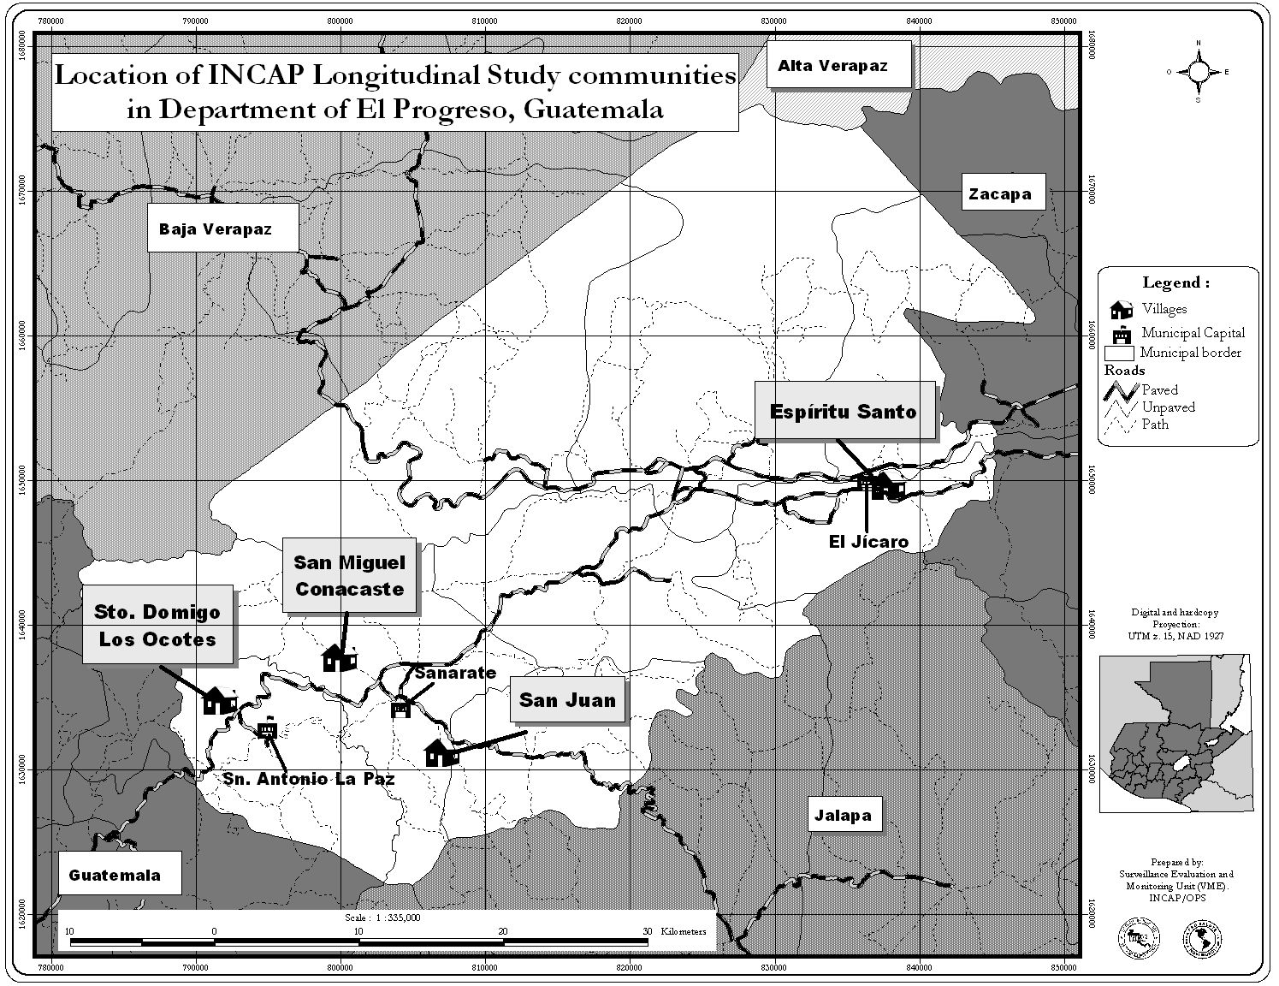
The 1969-77 Nutrition Intervention

Slide 13

Features of the intervention
Two matched-pair sets of villages (small & large)
Randomization into:
  Atole – high protein, high calorie, micronutrients
  Fresco – no protein, low calorie, micronutrients
Centrally located feeding center open at convenient hours, on-demand service
Free preventative healthcare including immunization and antiparasites campaigns
Enrolled all 0-7 year olds in 1969, all new births included until after supplementation abruptedly ended in 1977 (n=2392)
All study personnel were rotated periodically throughout the four villages

Slide 14
The 2002-04 Human Capital Study
Between 2002–04, we attempted to trace the 2392 participants in the 1969–77 study. Sample members ranged from 25 to 42 years of age.
We excluded individuals who were deceased (11%), international migrants (7%) or who were untraceable (4%).
We sought to find and interview the 1855 participants (78% of the original sample) who were alive and living in Guatemala in 2002.
  Of these, nearly 70% lived in or near the original study villages.
We successfully found and interviewed 1471 individuals (62% of the original sample; 79% of those targeted for interview)

Slide 15
The 2002-04 Human Capital Study
Over the two year period of the study, respondents completed four interviews (approximately eight hours in total) covering:
  Schooling, marital and fertility histories
  Took tests of reading and non-verbal cognitive ability
  Provided information on income and consumption
  Underwent physical examinations, took fitness tests and provided blood samples to measure blood glucose and cholesterol levels.
We commissioned archival work, focus groups and key informant interviews to obtain current and retrospective data on livelihoods in these villages, economic and other shocks, school quality, availability of health care and changes in infrastructure. This built on earlier qualitative studies of these villages

Slide 16
Selected impact of nutritional status on outcomes across the lifecourse
(+1 SD increase in HAZ at age 24m): Schooling
Outcome | Unit | β | P value
Age Start School | Years | -0.21 | 0.068
Age left school | Years | 0.54 | 0.025
Highest grade attained | Grades | 0.78 | 0.003
SIA z score | SD | 0.28 | 0.003
Raven's z score | SD | 0.25 | 0.002

Slide 17
Selected impact of nutritional status on outcomes across the lifecourse
(+1 SD increase in HAZ at age 24m): Marriage
Outcome | Unit | Β | P value
Age at first marriage | Years | 0.40 | 0.185
Partners’ age | Years | 1.39 | 0.006
Partners’ highest grade attained | Grades | 1.02 | 0.001
Partners’ height | cm | 1.01 | 0.046

Slide 18
Selected impact of nutritional status on outcomes across the lifecourse
(+1 SD increase in HAZ at age 24m): Fertility
Outcome | Unit | β | P value
Age at first birth | Years | 0.77 | 0.043
Number of pregnancies | Number | -0.63 | 0.003
Number of living children | Number | -0.43 | 0.032

Slide 19
Selected impact of nutritional status on outcomes across the lifecourse
(+1 SD increase in HAZ at age 24m): Labor market
Outcome | Unit | β | P value
Men
Wages | % | 14 | 0.080
Likelihood of operating own business | Percentage points | 4 | 0.279
Women
Wages | % | 5 | 0.745
Likelihood of operating own business | Percentage points | 11 | 0.010

Slide 20
Selected impact of nutritional status on outcomes across the lifecourse
(+1 SD increase in HAZ at age 24m): Consumption and poverty
Outcome | Unit | β | P value
Per capita household expenditure | % | 21 | 0.001
Poverty | Percentage points | -10 | 0.014

Slide 21
DISCUSSION

Slide 22
Discussion
Specific
Study team back in Guatemala for follow up survey:
  Update findings on wages, human capital to see if these effects persist or fade out
  Additional focus on health and agency
General
Conventional wisdom has been to see nutrition (broadly defined) as a consequence or outcome of (general) development processes
These findings suggest that, at the very least, much more weight should be given to seeing this relationship from the other direction; from better nutrition to (economic) development

