Slide 1
Sustainability Science:
Conceptual frameworks, achievable goals, research frontiers
Presented at
Cornell University -- May 5, 2015
by
Bill Clark
Harvey Brooks Professor of International Science, Public Policy and Human Development
Harvard Kennedy School of Government
(william_clark@harvard.edu)
on behalf of a team of coauthors:
Partha Dasgupta, Bill Turner, Pam Matson, Bob Kates,
John Schellnhuber, Lin Ostrom† et al.
Notes:
Purpose: Overview of key problems in the field, drawing from meetings + book team

Slide 2

Sustainable Development:
“The central challenge of our generation”
“Environment is where we live;
Development is what we all do in attempting to improve our lot within that abode.
The two are inseparable….”
“Humanity has the ability to make development sustainable…“

Slide 3

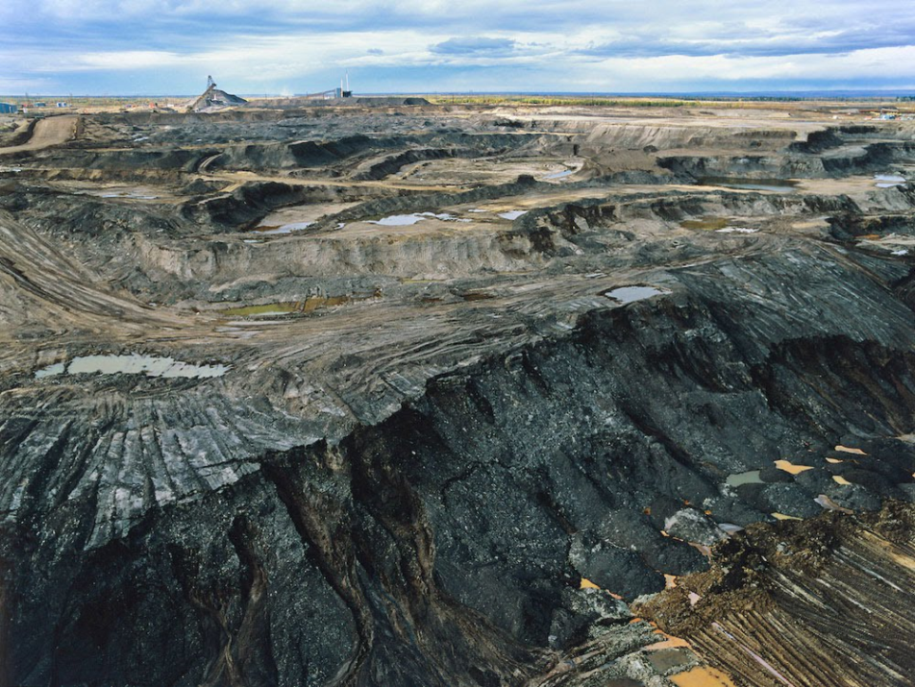
Humanity has the ability to make development sustainable…“
global ENERGY demand
2015 →2050:
+40%

Slide 4
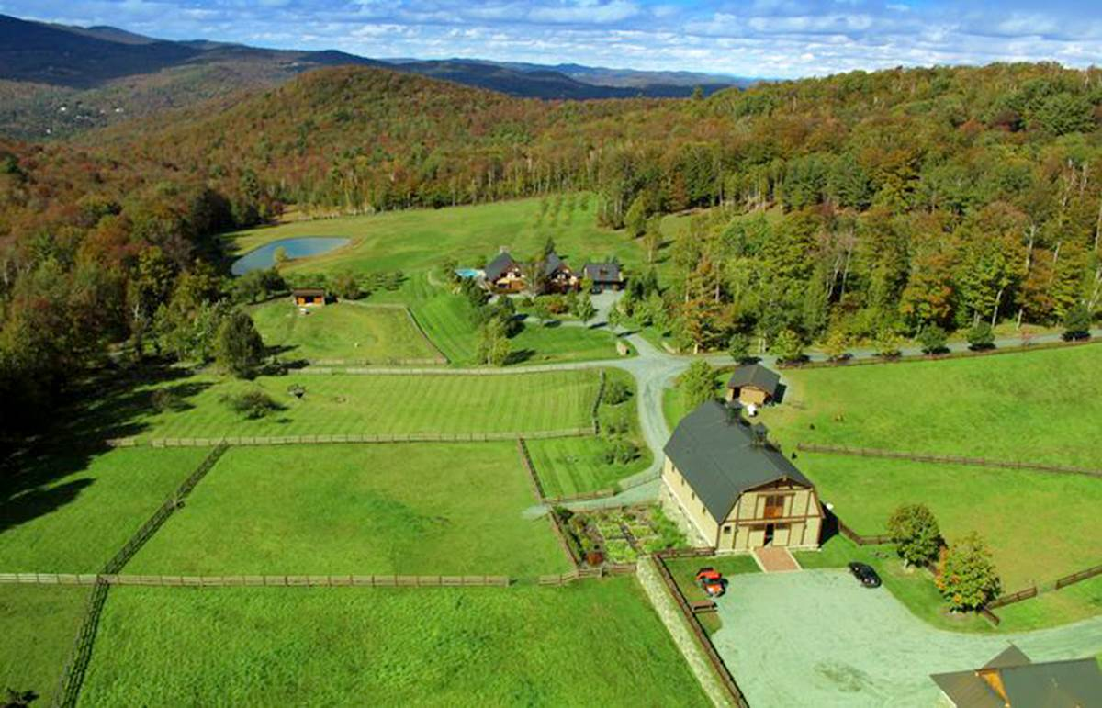
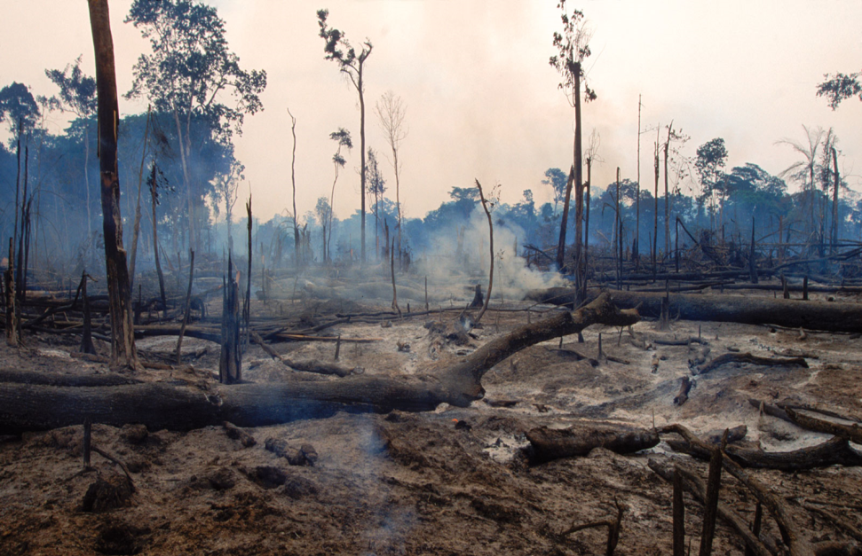
Humanity has the ability to make development sustainable…“
global FOOD demand
2015 →2050:
+50%

Slide 5
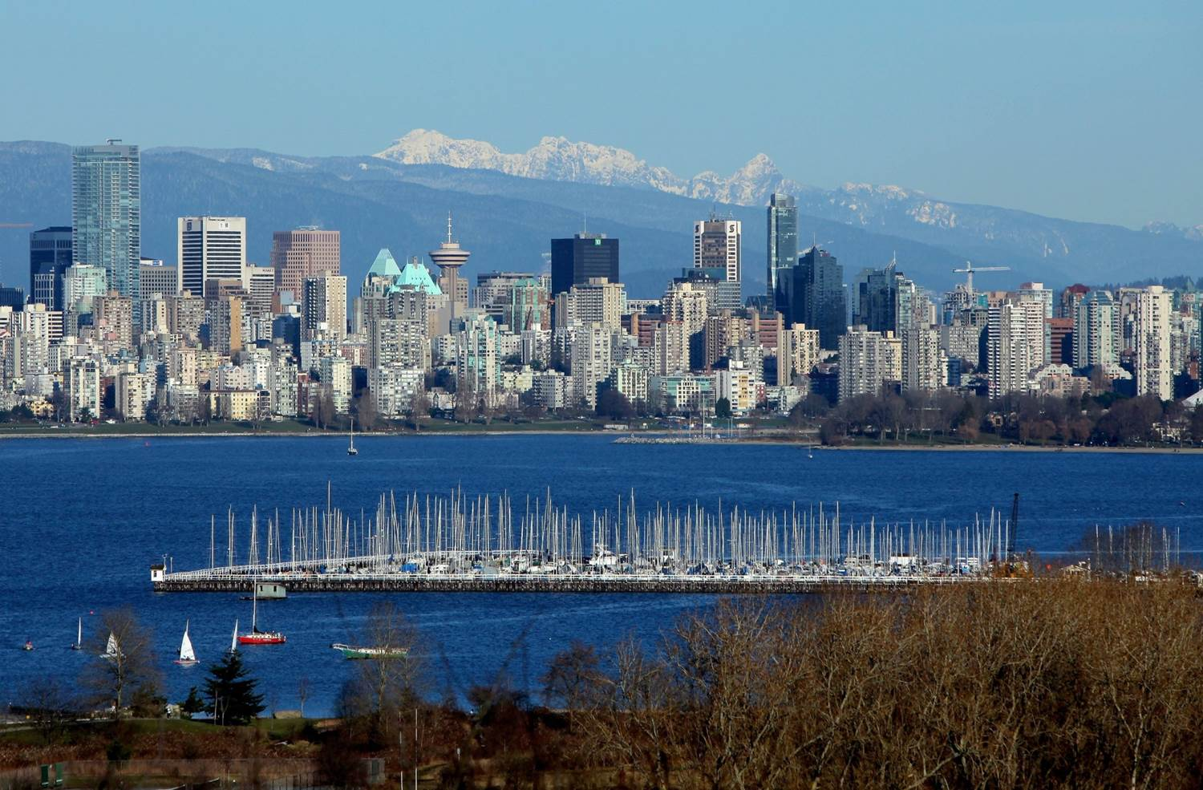
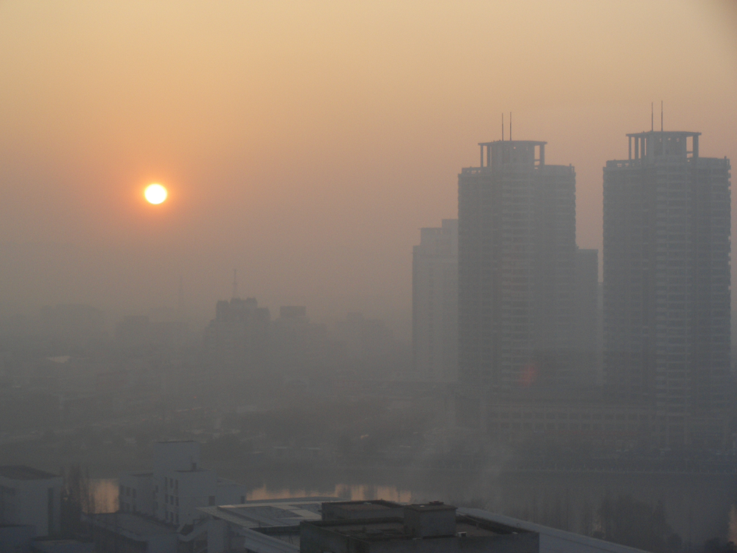
Humanity has the ability to make development sustainable…“
global URBAN demand
2015 →2050:
+60%

Slide 6
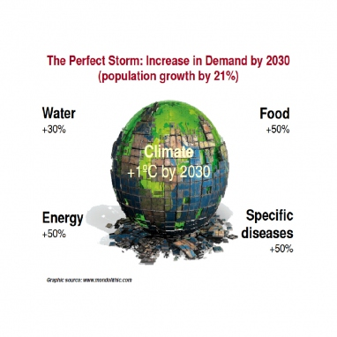
Interconnected needs of 9B people… Heading toward “A Perfect Storm”
(Beddington, 2009)
Notes:
Beddington J. 2009. FOOD, ENERGY, WATER AND THE CLIMATE: A PERFECT STORM OF GLOBAL EVENTS?
. London: Government Office for Science; UK Department of Business, Innovation and Skills

Slide 7
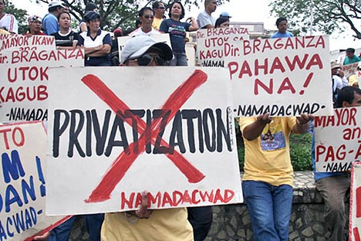
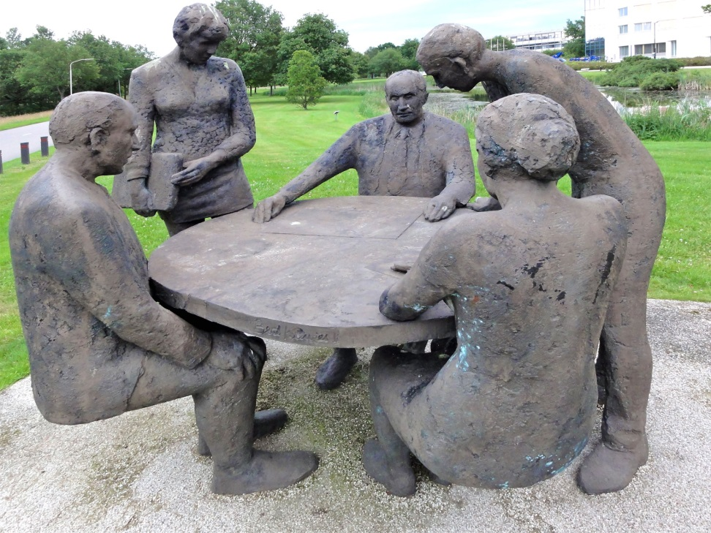
Navigating through the storm:
A transition toward sustainability…
Bottom line: Need “informed agitation” for sustainable development
Notes:
The phrase is from Sen, Amartya. 2013. “The ends and means of sustainability." Journal of Human Development and Capabilities. 14 (1):6-20.

Slide 8



Sustainability Science: “Informing agitation” for
Sustainable Development?

Slide 9
Sustainability Science today…
An emerging field of ‘use-inspired’ research and innovation, like ‘agricultural science’ before it;
Defined by the practical problems it addresses, i.e. the problems of sustainable development;
Conducted by drawing from and integrating basic research on social-environmental systems from the natural, social, medical and engineering sciences;
Committed to linking knowledge with action through the design, implementation & adaptation of improved practices, technologies and policies...

Slide 10
… working in “Pasteur’s Quadrant”
Improved understanding
Improved policy and technology
Use-inspired basic research
(Sustainability Science)
Purely basic research
Purely applied
R&D
Existing understanding
Existing policy and technology
(redrawn from Stokes, 1997)
Notes:
Stokes DE. 1997. Pasteur's quadrant : Basic science and technological innovation. Washington, D.C.: Brookings Institution Press.

Slide 11
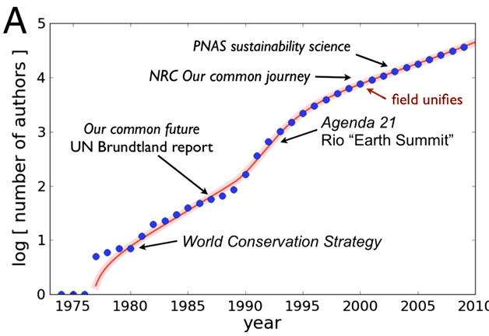
… and building a growing research literature
IIASA Sustainable Development
Earth Transformed by Human Action
(Bettencourt et al. 2011)
Notes:
Bettencourt, Luís M. A., and Jasleen Kaur. 2011. Evolution and structure of sustainability science. Proceedings of the National Academy of Sciences 108 (49) (December 06): 19540-5.

Slide 12
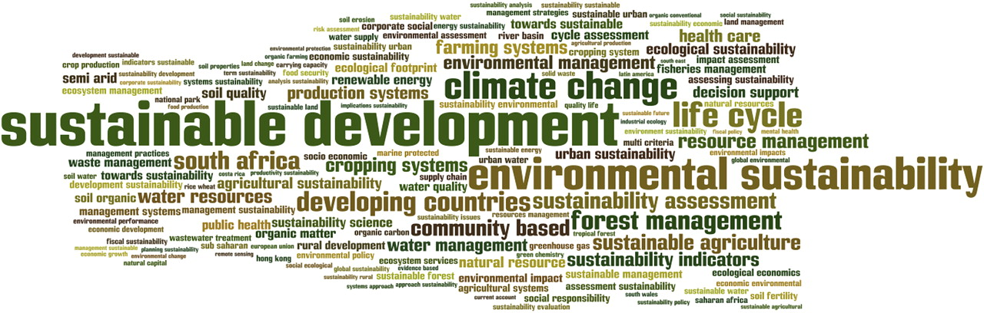
Current Research Topics
in
Sustainability Science
Notes:
Reproduced from Bettencourt & Kaur. PNAS 2011;108:19540-19545: “Word cloud for paper title bigrams. Bigrams (consecutive 2-word combinations, obtained after frequent stop words were removed) often give a better sense of subjects addressed than the single words. The frequency of sustainable development has been reduced by 35%, so that other terms would be more visible. The figure was generated using Wordle (available online at http://www.wordle.net).... All items in the collection are publications written in English between 1973 and the end of 2009…. The corpus discussed here comes from key word searches on “sustainability” in title, subject, or abstract for all years and databases: Science Citation Index Expanded,Social Sciences Citation Index and Arts, and Humanities Citation Index. The data contain 23,211 records (June 2010), with 20,376 until the end of year 2009. Similar searches for “sustainable development” yielded a subset of this corpus that was correct but substantially more incomplete, with 16,647 records through the end of 2009.”

Slide 13
Grand Challenges of Sustainability Science?
A) Normative challenges
  How should values inform sustainability science?
B) Analytic challenges
  How do the workings of social-environmental systems affect the prospects for sustainable development?
C) Operational challenges
  What kinds of methods, models and data are most needed to help us do sustainability science better?
D) Strategic challenges
  What does sustainability science say about which actions can best promote sustainable development?
Notes:
Trenches : Most of the useful S&T for SD is exacting work in the trenches of applied research on WEHAB in particular places and contexts
Continuing need for basic research on HES…
Common challenges in the middle: That said, there also turn out to be some common challenges that eventually confront most of us doing such work. …. Reason for a ‘field’ is to recognize those common challenges, pool our collective experience, get better at meeting them.
Categories: What are the challenges? You can do your own list. But a set of helpful categories has emerged (Schellnhuber)… Describe.
Work: What’s going on in meeting those challenges? More than anyone knows… Certainly more than have time for here. (See Kates Reader) So … some personal examples of where I think progress has been made.
BC: Thrust here is not to be comprehensive, but rather suggestive of real progress. Goal is to show big tent, and places for scholars of various stripes to engage

Slide 14
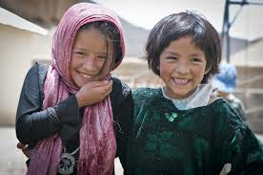

  A) Normative: How should values inform sustainability science?
1) What is to be developed?

Slide 15
  A) Normative: How should values inform sustainability science?
1) What is to be developed?
Sustainable development defined in terms of
“human needs” → well-being
(material needs, health, education, security, biophilia, community, capability…)

Slide 16
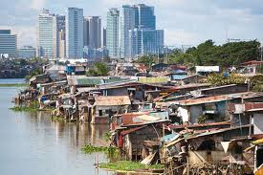

  Values in sustainability science
1) What is to be developed?
Human Well-being !
2) How much to value equity?
Notes:
Lower right figure: About the Artist
Brie O’Malley works at City Year Headquarters as the Regional Recruitment Director for the Northeast Region. She and her husband recently returned to New England after many years in New York City. She said,“I wanted to depict the ‘Seven Generations’ founding story from a global perspective, since so many of our decisions have potential worldwide impact. For that reason, I chose patterns inspired by locations across the globe to dress the seven Russian Matryoshka nesting dolls.” http://www.cityyear.org/CityYear/6_About_City_Year/Culture/Founding_Stories/Seven_Generations.aspx

Slide 17
  Values in sustainability science
1) What is to be developed? Human well-being!
2) How much to value equity?
Human Well-being measured Inclusively
across all people
(here and there,
now and in the future)

Slide 18


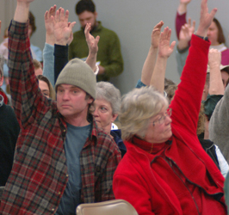
  Values in sustainability science
What is to be developed? Human well-being
How equitably? Inclusively (space and time)
Who decides (the weights, e.g. discounting)?
Challenge for sustainability science is to integrate rigorous
analysis & procedural justice in proposing equity weights (Dasgupta)

Slide 19
  A) Normative challenges
What is to be developed?
  Inclusive well-being (conserving nature as one possible means for, not end of, sustainability)
How much to value equitably?
  Inclusive well-being (across space and time)
Who decides the weights?
  Sustainability scientists integrating commitment to rigorous analysis and procedural justice
Bottom line…
  Goal of SD is non-declining inclusive well-being…
  As assessed by socially committed analysts (Yikes!)

Slide 20
Grand Challenges of
Sustainability Science?
A) Normative challenges
  SD as non-declining inclusive well-being?
B) Analytic challenges
  How do the workings of social-environmental systems affect the prospects for sustainable development?
C) Operational challenges
  What kinds of methods, models and data are most needed to help us do sustainability science better?
D) Strategic challenges
  What does sustainability science say about which actions can best promote sustainable development?

Slide 21
B) Analytic: How do the workings of SES affect ‘inclusive human well-being’?
(IGBP, IHDP, Future Earth, etc.)

Slide 22
Focus on the determinants of Inclusive Human Well-being?
A family tree example: What do we need to pass on to the next generation to provide it with an opportunity equal to that given us from which it can shape its own version of inclusive well-being?
  Not flows (e.g. consumption) but stocks (e.g. assets)
Which assets?
  Those that form the “productive base” from which the family’s well-being flows (house, health, education, etc.)
    (Eakins, Hamilton, Goran-Maler, Dasgupta, Arrow, WB et al.)

Slide 23
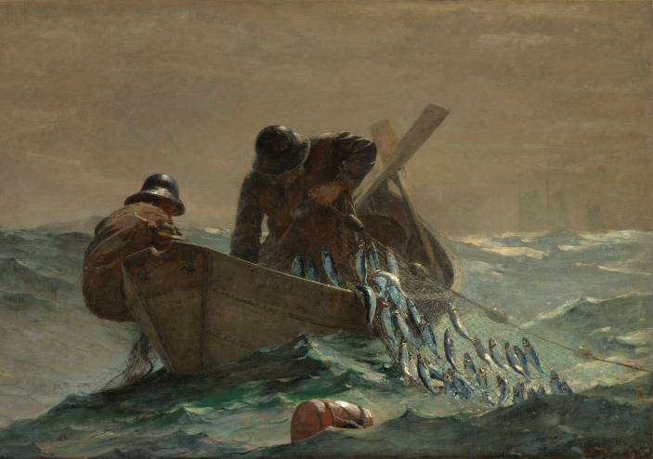
“Productive assets” for a
New England Fisher Family
“Productive Base”
Natural capital
Human capital
Manufactured cap
Social capital
Knowledge capital
    (Eakins, Hamilton, Goran-Maler, Dasgupta, Arrow, WB et al.)

Slide 24
Determinants of Inclusive well-being
(And tribes of sustainability scientists that study them)
Determinant cluster | Includes… “state variables” related to…. | Studied by scholars of Geography and…
Natural capital | Environmental system, its ecology, climate, soils, biodiversity, minerals, etc. | Earth systems science, conservation biology, ecosystem services, ecological economics
Manufactured capital | Industrial system: factories, roads, cities, infrastructure for energy, telecom, etc. | Industrial ecology, green design, pollution control; sustainability engineering
Human capital | Individuals: number/distribution, health, education, networks | Demography, consumption behavior, environmental health
Social capital | Arrangements (economic, political, cultural) governing interactions (rules, norms, trust) | Political economy, institutions, policy science, managing the commons, governance, sociology
Knowledge capital | Scientific findings, technology, practical skills and expertise | Research policy, innovation, STS, boundary work, social learning…

Slide 25
B) Analytic Framework for Sustainability
Constituents of Well-Being
Goals of SD (ends)
*material Needs …
*human Capabilities…
*flourishing Nature
Consumption Processes
Sustainable development is the management of assets such that social worth of the productive base does not decline…
Agents of Action (agitators)
Goods & Services
Production Processes
Determinants of Well-being
Human capital (C_{h})
Natural capital (C_{n})
Manufactured capital (C_{m})
Knowledge capital (C_{k})
Social capital (C_{s})
Productive Base (assets/means)

Slide 26

W = f (C_{n}, C_{h}, C_{m}, C_{s}, C_{k} |chance)
Constituents of Well-Being
Goals of SD (ends)
*material Needs
*human Capabilities
*flourishing Nature
Consumption Processes
Agents of Action (agitators)
Goods & Services
f
Production Processes
Determinants of Well-being
Human capital (C_{h})
Natural capital (C_{n})
Manufactured capital (C_{m})
Knowledge capital (C_{k})
Social capital (C_{s})
Productive Base (assets/means)

Slide 27
B) Analytic challenges:
Why can’t we just muddle through?
SESs (f) are complex adaptive systems
Heterogeneity + selection → adaptation
  rules governing dynamics change as a result of experience, (eg. antibiotic resistance, flood plain settlements, innovation)
  But neither the creation of variation nor “natural” selection favor sustainability. Why?
Invisibilities (ignorance, externalities)
  operate across multiple time/space scales…
Notes:
Illustrate last item

Slide 28
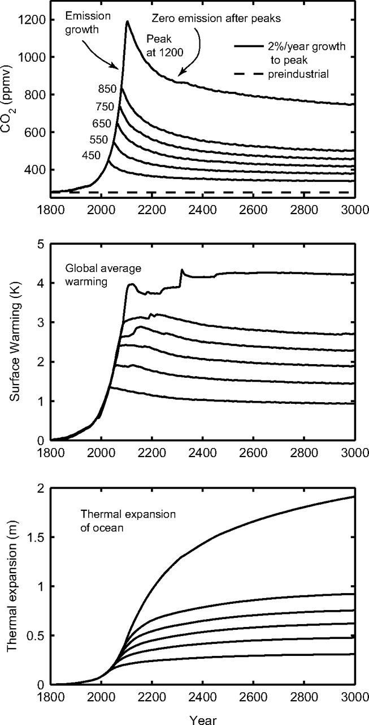
Externalities in Time:
Present actions primarily impact people not yet born
Solomon et al. PNAS (2009)
Notes:
Solomon, Susan, Gian-Kasper Plattner, Reto Knutti and Pierre Friedlingstein. 2009. Irreversible climate change due to carbon dioxide emissions." Proceedings of the National Academy of Sciences. 106 (6):1704-1709.

Slide 29
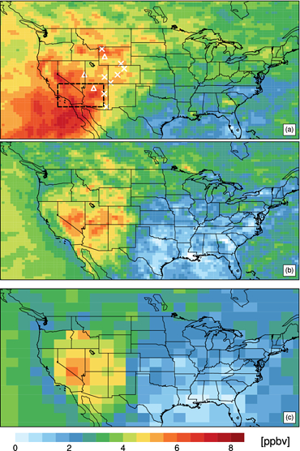
Externalities in space:
Local actions impact people far away
Transport of Asian ozone pollution into surface air over the western United States
Journal of Geophysical Research: Atmospheres
Volume 117, Issue D21, D00V07, 17 FEB 2012 DOI: 10.1029/2011JD016961
Notes:
Lin, M., Fiore, A. M., Horowitz, L. W., Cooper, O. R., Naik, V., Holloway, J., et al. (2012). Transport of asian ozone pollution into surface air over the western united states in spring. Journal of Geophysical Research: Atmospheres (1984–2012), 117(D21)
Asian pollution enhancements to (a) mean ozone mixing ratios at ∼800 hPa and (b) daily maximum 8‐h ozone in surface air for May–June 2010, estimated with ∼50 km AM3. (c) Same as Figure 9b, but for ∼200 km AM3. The dashed rectangle in Figure 9a indicates the surface region analyzed inFigure 10. The symbols denote locations of 12 CASTNet high‐elevation sites shown inFigure S8b.

Slide 30
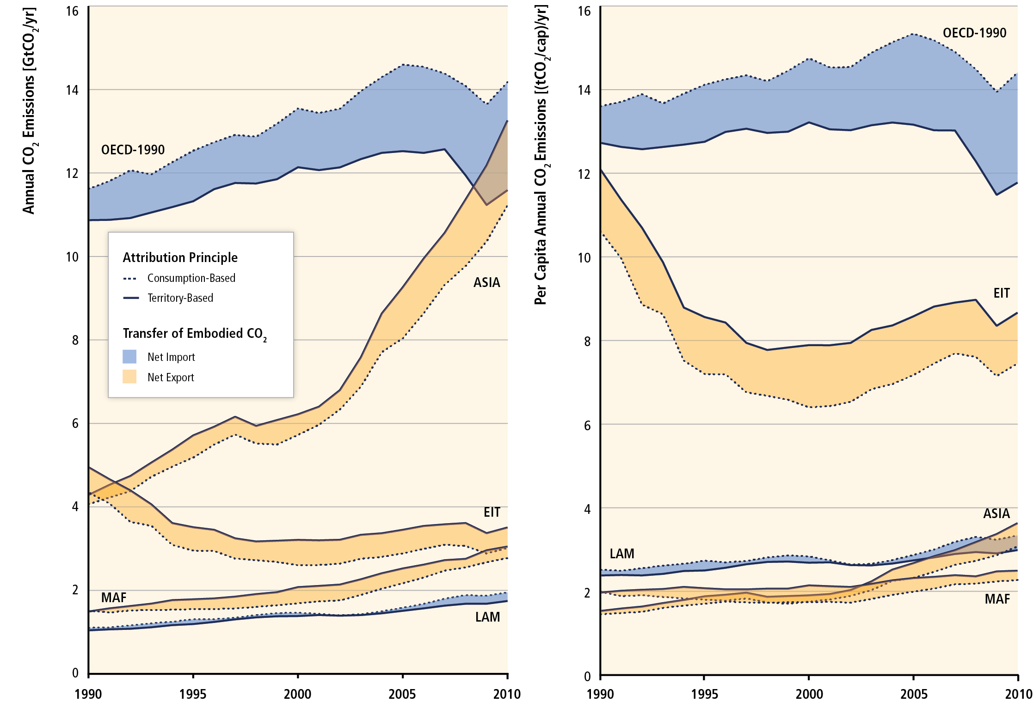
More externalities in space:
Production vs Consumption CO2 emissions
(IPCC, 2014)
Notes:
Source: Blanco G., R. Gerlagh, S. Suh, J. Barrett, H.C. de Coninck, C.F. Diaz Morejon, R. Mathur, N. Nakicenovic, A. Ofosu Ahenkora, J. Pan, H. Pathak, J. Rice, R. Richels, S.J. Smith, D.I. Stern, F.L. Toth, and P. Zhou, 2014: Drivers, Trends and Mitigation. In: Climate Change 2014: Mitigation of Climate Change. Contribution of Working Group III to the Fifth Assessment Report of the Intergovernmental Panel on Climate Change [Edenhofer, O., R. Pichs-Madruga, Y. Sokona, E. Farahani, S. Kadner, K. Seyboth, A. Adler, I. Baum, S. Brunner, P. Eickemeier, B. Kriemann, J. Savolainen, S. Schlömer, C. von Stechow, T. Zwickel and J.C. Minx (eds.)]. Cambridge University Press, Cambridge, United Kingdom and New York, NY, USA. Figure 5.14
Caption: Figure 5.14 | Territory-based versus consumption-based CO2 emissions in five world regions, from 1990 to 2010 | The left panel presents total emissions, while the right panel presents per capita emissions. The blue areas indicate that a region is a net importer of embodied CO2 emissions. The yellow area indicates a region is a net exporter of embodied CO2 | Regions are defined in Annex II.2. EIT=economies in transition, E Eur and part of former USSR; MAF= mid east and Africa; LAM=Latin America and Carrib.; OECD1990 = members in 1990, ie. Namer, Eur, Japan, Aust, NZ; ASIA=non-OECD Asia.

Slide 31
B) Analytic challenges:
Why can’t we just muddle through?
SESs (f) are complex adaptive systems
Variability + selection → adaptation
Invisibilities (ignorance, externalities)
Complexity:
  “You can’t just do one thing… ” (eg. biofuel)
Notes:
Illustrate last item

Slide 32
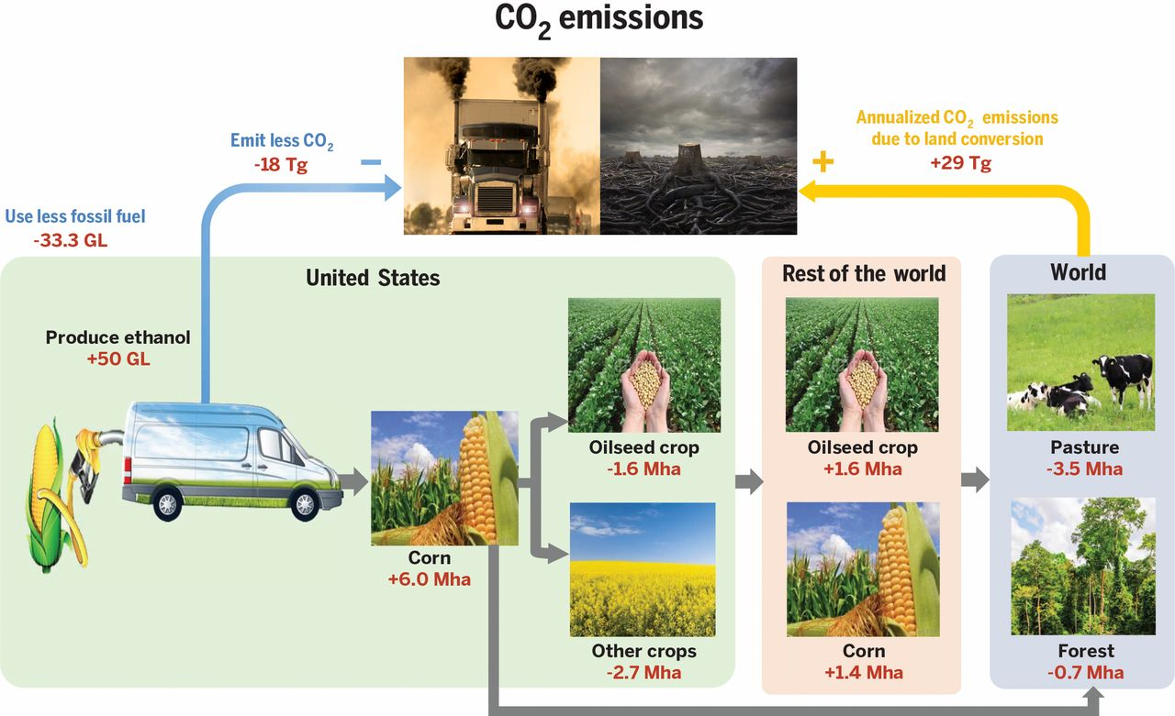
Complexity (you can’t do just one thing) Cascading impacts of US biofuel mandate
Jianguo Liu et al. Science 2015;347:1258832
Notes:
Liu, J., Mooney, H., Hull, V., Davis, S. J., Gaskell, J., Hertel, T., et al. (2015). Systems integration for global sustainability. Science, 347(6225) doi:10.1126/science.1258832
Cascading and spillover effects of biofuel production on land conversion and CO₂ emissions, as revealed by systems integration.Meeting the Renewable Fuel Standard mandate [to produce 50 Gigaliters (GL) of additional ethanol on top of the 2001 production level] in the United States reduces the use of petroleum but requires additional corn area (99). The expansion in U.S. corn area leads to reduction in harvested area of oilseeds and other crops in the United States. This boosts world prices for these crops and encourages more production of oilseeds and corn in the rest of the world. The expansion of cropland in the United States and the rest of the world leads to more emissions of CO₂ and the conversion of pasture and forest lands around the world. This land conversion also releases CO₂, offsetting the reduction of CO₂ emissions from using less fossil fuels and more biofuels (assuming a 2/3 ethanol/petroleum energy conversion rate). Estimates are on an annual basis over a 30-year production period for the biofuel facilities and in approximate amounts derived from (99). Arrows indicate the direction of influences. Symbols “–” and “+” refer to decrease and increase, respectively, in land area, ethanol, fossil fuel, or CO₂. Tg, teragrams; Mha, million ha. [Graphics are used with permissions from Fotolia.com]

Slide 33
B) Analytic challenges:
Why can’t we just muddle through?
SESs (f) are complex adaptive systems
Variability + selection → adaptation
Invisibilities (ignorance, externalities)
Complexity (cant do just one thing…)
  Thresholds/discontinuities
    limit “try & see” approaches (eg. poverty traps, ice-sheet collapses, pandemics)
Notes:
Illustrate last item

Slide 34
Tipping points, Regime shifts

Slide 35
Tipping points in the climate system
  (Lenton et al. 2008)
Notes:
Lenton, Timothy M., Hermann Held, Elmar Kriegler, et al. 2008. Tipping elements in the earth's climate system." Proceedings of the National Academy of Sciences. 105 (6):1786-1793

Slide 36
Tipping points as poverty traps
(Barrett & Constas, 2014)
Notes:
Barrett, C. B., & Constas, M. A. (2014). Toward a theory of resilience for international development applications. Proceedings of the National Academy of Sciences, 111(40), 14625-14630. doi:10.1073/pnas.1320880111

Slide 37
B) Analytic challenges:
Why can’t we just muddle through?
SESs (f) are complex adaptive systems!
Heterogeneity + selection → adaptation
Invisibilities (ignorance, externalities)
Complexity (can’t do just one thing)
  Thresholds/discontinuities
Polycentric / transition governance
    Need to reconcile local, short term interests with global long term ones (eg ‘climate clubs’)
Notes:
Illustrate last item

Slide 38
B) Analytic challenges: research Implications of SESs as complex adaptive systems
Acknowledge the limits of predictability, and thus of social cost / benefit framing of challenge:
  always remain unknowns, complexities, invisibilities, exogenous factors you can’t or don’t bother to model…
  See critiques of IPCC and other integrated assessments
Focus on identifying structural changes that have general capacity to promote SD in a complex, adaptive, surprising world…
  Light up the invisibilities (unknowns, externalities)
  Map and monitor thresholds (“safe operating spaces”)
  Invent stronger polycentric governance arrangements
  Develop theory of general coping capacity (including resilience, vulnerability, adaptation)
Notes:
Illustrate last item

Slide 39
Coping with the unknown in SES:
Resilience, Vulnerability and Adaptation
SES characteristics (now)
SES characteristics* (later)
Social subsystem
Social subsystem*
Coping Capacity
Response Processes
Coping Capacity*
Dist
Exposure
System interactions*
Dist
Challenges
Outcomes
System interactions
(to absorb,
to adapt)
adjustment
adaptation
(to absorb,
to adapt)
Environmental subsystem
time
Environmental subsystem*
time
Cross-scale
interactions
Place
Outside place
  (Clark, Turner et al., 2015)
Notes:
Clark, WC and BL Turner. Unpublished. Coping with challenges: Analyzing Resilience and Vulnerability in Social-Environmental Systems (SES)
An SES in a particular place is can be seen developing through time as a function of its own internal interactions within and between its social and environmental subsystems plus its external interactions with systems at other scales. This development of the SES is continually perturbed by multiple challenges, some originating endogenously as a result of system dynamics, others originating exogenously, from outside the particular SES. Only some parts of the SES will be directly exposed to such challenges. The SES’s ability to sustain its development in the face of these challenges is a function of the challenges themselves, exposure of different parts of the system to the challenges, and the system’s capacities to absorb those challenges or adapt to them. These capacities support the response processes of adjustment and adaptation of the SES in response to the disturbances. SES dynamics, reflecting the challenges, responses to them, and interactions with the world “outside” the system, result in the outcome of a later set of SES characteristics, potentially including altered state, interactions, capacities, and endogenously generated disturbances (all indicated by the * superscript in the figure.) These outcomes – these “later” SES characteristics* -- alter the stage on which the next cycle of SES development will be played out. Given our focus on sustainable development, the outcome of interest in these responses of the SES system to disturbance is whether the inclusive social well being of the “later” SES is greater than that of the earlier one. If so, we can say that the resilience of the system has proven adequate to advance sustainable development in the face of the particular challenges that occurred; if not, we can say that significant components of the SES proved vulnerable to those challenges.

Slide 40
Grand Challenges of
Sustainability Science?
A) Normative challenges
  How should values inform sustainability science?
B) Analytic challenges
  How do the workings of human-environment systems affect sustainable development (inclusive well-being)?
C) Operational challenges
  What kinds of methods, models and data are most needed to help us do sustainability science better?
D) Strategic challenges
  What does sustainability science say about which actions can best promote sustainable development?
Notes:
Operational challenges
How can we do sustainability science better? // How to do (compute) evaluation ; also engage locals, co-production….

Slide 41
Operational Challenges: Data
Need for shared canonical puzzles…
  What is sustainability science’s Mauna Loa record, Wytham Woods, Middletown, …. ?
  Turn to environmental history, anthropology?
Integration of spatially explicit data
  How can we better generate, process and integrate relevant data sets about the social and environment components of SESs?
Notes:
Middletown is a sociological / anthropologicla study by Robert and Helen Lynd of Muncie Indiana

Slide 42
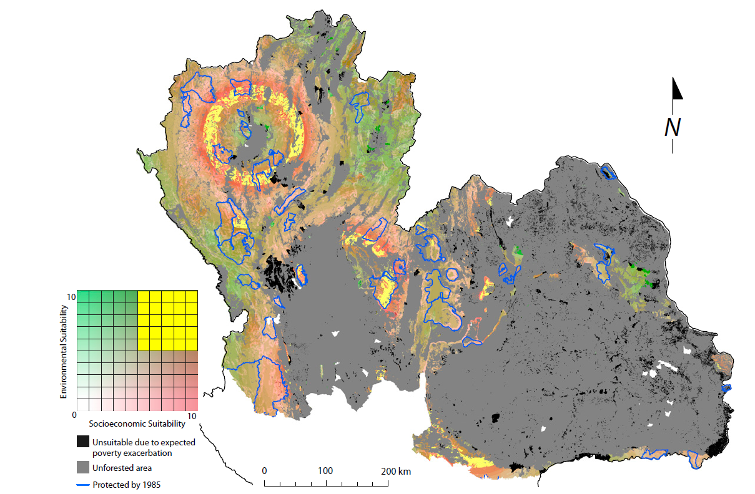
Data: Mapping Suitability
for win-win land use
(Ferraro et al., 2011)
Notes:
Source: Ferraro, Paul J., Merlin M. Hanauer, and Katharine R. E. Sims. 2011. Conditions associated with protected area success in conservation and poverty reduction. Proceedings of the National Academy of Sciences 108 (34) (August 23): 13913-8.
Abstract: Protected areas are the dominant approach to protecting biodiversity and the supply of ecosystem services. Because these protected areas are often placed in regions with widespread poverty and because they can limit agricultural development and exploitation of natural resources, concerns have been raised about their potential to create or reinforce poverty traps. Previous studies suggest that the protected area systems in Costa Rica and Thailand, on average, reduced deforestation and alleviated poverty. We examine these results in more detail by characterizing the heterogeneity of responses to protection conditional on observable characteristics. We find no evidence that protected areas trap historically poorer areas in poverty. In fact, we find that poorer areas at baseline seem to have the greatest levels of poverty reduction as a result of protection. However, we do find that the spatial characteristics associated with the most poverty alleviation are not necessarily the characteristics associated with the most avoided deforestation. We show how an understanding of these spatially heterogeneous responses to protection can be used to generate suitability maps that identify locations in which both environmental and poverty alleviation goals are most likely to be achieved.

Slide 43
Operational Challenges: Methods
Reporting on history of progress to sustainability
  Build on World Bank (“Real wealth of nations”) and UN (“Inclusive Wealth Report”) reports on trends in capital assets to incorporate treatment of social and knowledge capital
  Scale from current national focus to address regional and urban level (like OECD “Better Life” Index has done for current well-being)

Slide 44
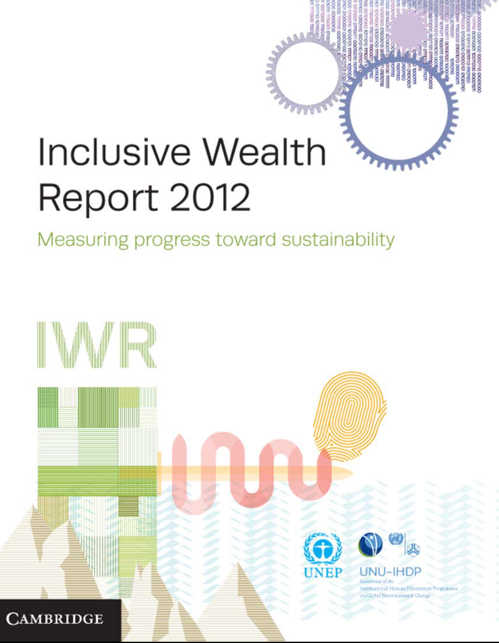
Global comparisons characterize countries’
(C_{n}, C_{h}, C_{m}, C_{s}, C_{k})
Rank national performance in W
Notes:
UNU-IHDP UNEP. 2012. Inclusive wealth report 2012: Measuring progress toward sustainability (Cambridge: Cambridge Univ. Press).

Slide 45
Operational Challenges: Methods
Reporting on history of progress to sustainability
  Beyond World Bank (“Real wealth of nations”) and UN (“Inclusive Wealth Report”) reports on nations to incorporate treatment of social and knowledge capital
  Scale to regional and urban level (OECD “Better Life”)
Boundary work
  Develop better processes, methods for carrying out the “Janus-like” role of sustainability science, integrating stakeholder and scholarly perspective on particular problems
  “Extension services” for sustainability?

Slide 46
“Boundary-work” to support adaptive management
The ‘Alternatives to Slash and Burn’ Program
Farmers, local communities
Policymakers and Public Policy Shapers
Other Private Sector Managers and Investors
ASB
NGOs,
Civil Society
Notes:
Tomich TP, Timmer DW, Velarde SJ, Alegre J, Areskoug V, Cash DW, Cattaneo A, Ericksen P, Joshi L, Kasyoki J, et al. 2007. Integrative science in practice: Process perspectives from ASB, the partnership for the tropical forest margins. Agric Ecosyst Environ 121(3):269-86.

Slide 47
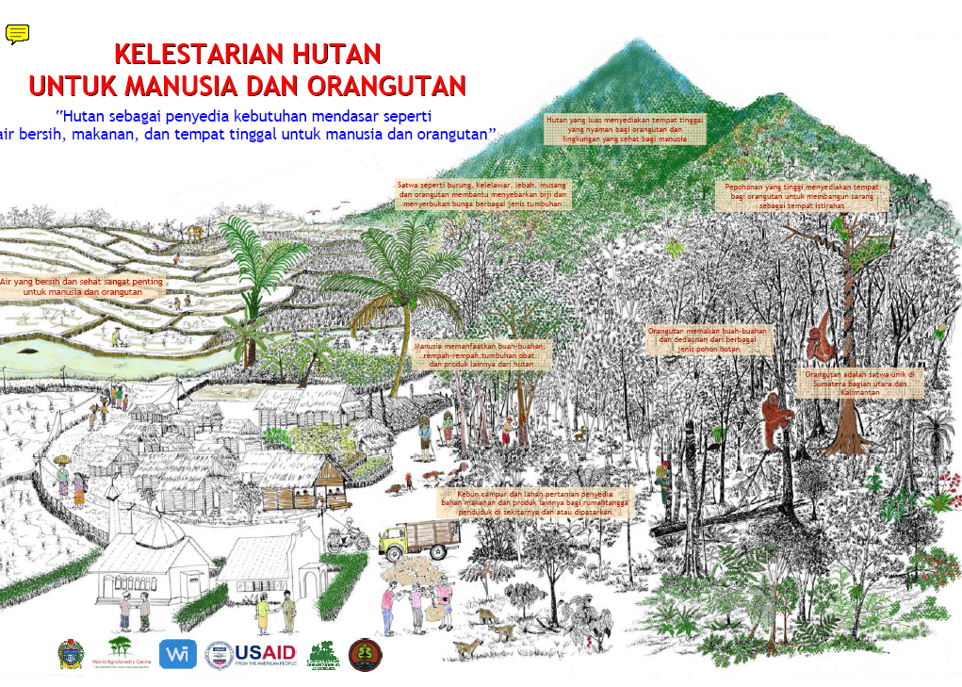
A Boundary (spanning) Object…
Notes:
O'Connor T, Manurung G, Roshetko JM. 2006. Preservation of forests for humans and orangutans: "the forest as a provider of basic needs like clean water, food, and shelter for humans and orangutans" (kelestarian hutan untuk manusia dan orangutan: "hutan sebagai penyedia kebutuhan mendasar seperti air bersih, makanan, dan tempat tinggal untuk manusia dan orangutan"). Bogor, Indonesia: World Agroforestry Centre - ICRAF, SEA Regional Office. Report nr PO0074-07.

Slide 48
Operational Challenges: Models
Reconcile strengths and weaknesses of
  “general equilibrium” / integrated assessment models of economics/ climatology/ biogeochemistry / energy
  Agent-based disruptive models for handling innovation, contextual heterogeneity, adaptation
Develop decision-support models specifically for the multidimensional “asset management” that is the essence of sustainable development
  Beyond the “island empires” of InVest for natural capital, LCA for manufactured capital, risk attribution for human (health) capital…

Slide 49
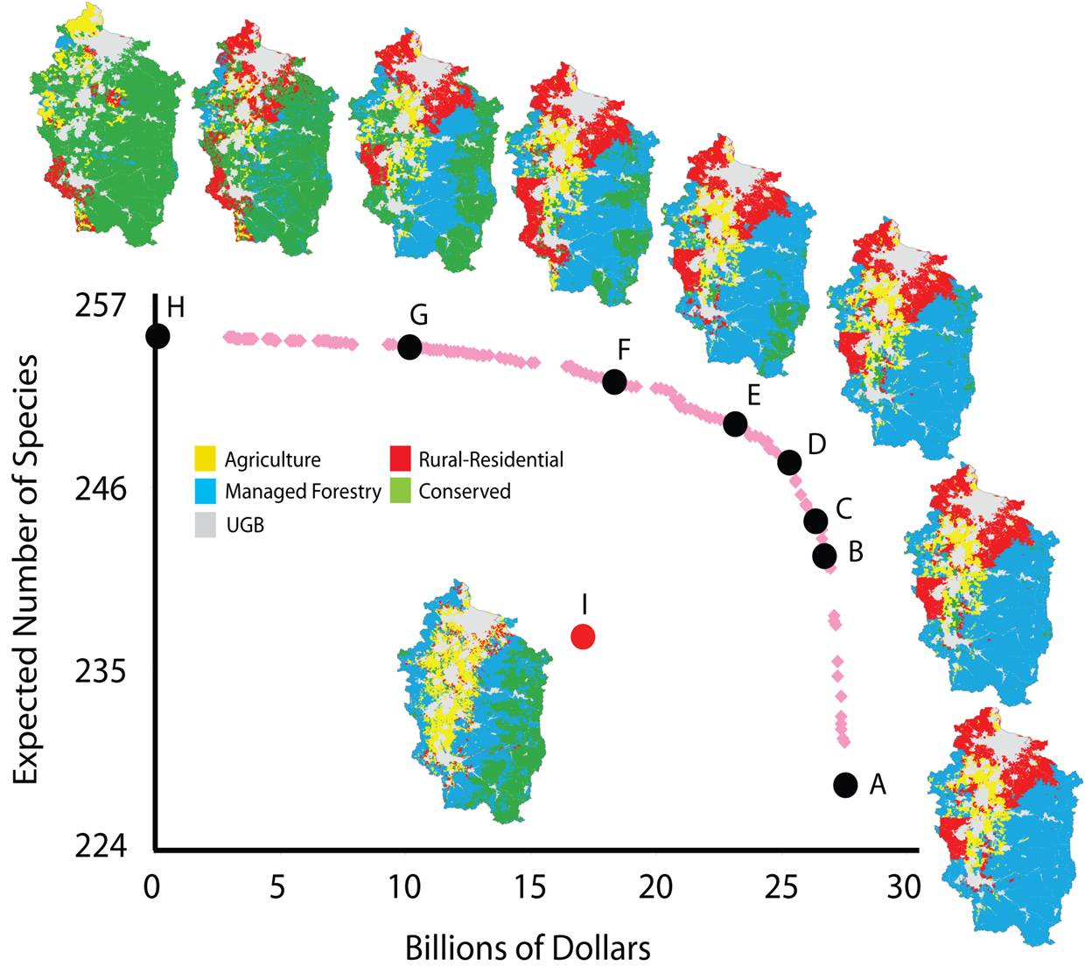
Regional trade-offs
(W vs C_{n})
270km
(Polasky et al. 2008)
Notes:
49
Source: Polasky S, Nelson E, Camm J, Csuti B, Fackler P, Lonsdorf E, Montgomery C, White D, Arthur J, Garber-Yonts B, et al. 2008. Where to put things? spatial land management to sustain biodiversity and economic returns. Biol Conserv 141(6):1505-24., Fig. 3.

Slide 50
Grand Challenges of
Sustainability Science?
A) Normative challenges
  How should values inform sustainability science?
B) Analytic challenges
  How do the workings of human-environment systems affect sustainable development (inclusive well-being)?
C) Operational challenges
  What kinds of methods, models and data are most needed to help us do sustainability science better?
D) Strategic challenges
  What does sustainability science have to say about informed agitation for sustainable development?
Notes:
Close with some of my favorite examples, ranging from local to global…..

Slide 51

Local co-production
Participatory SD
Decadal scale
Interdisciplinary W = f (C_{n}, C_{h}, C_{m}, C_{s}, C_{k})
Self-critical, learning lab….
Career track?
Notes:
Matson, Pamela, ed. 2012. Seeds of sustainablility : Lessons from the birthplace of the green revolution. Washington, DC: Island Press, http://hollis.harvard.edu/?itemid=%7Clibrary/m/aleph%7C013104912.

Slide 52
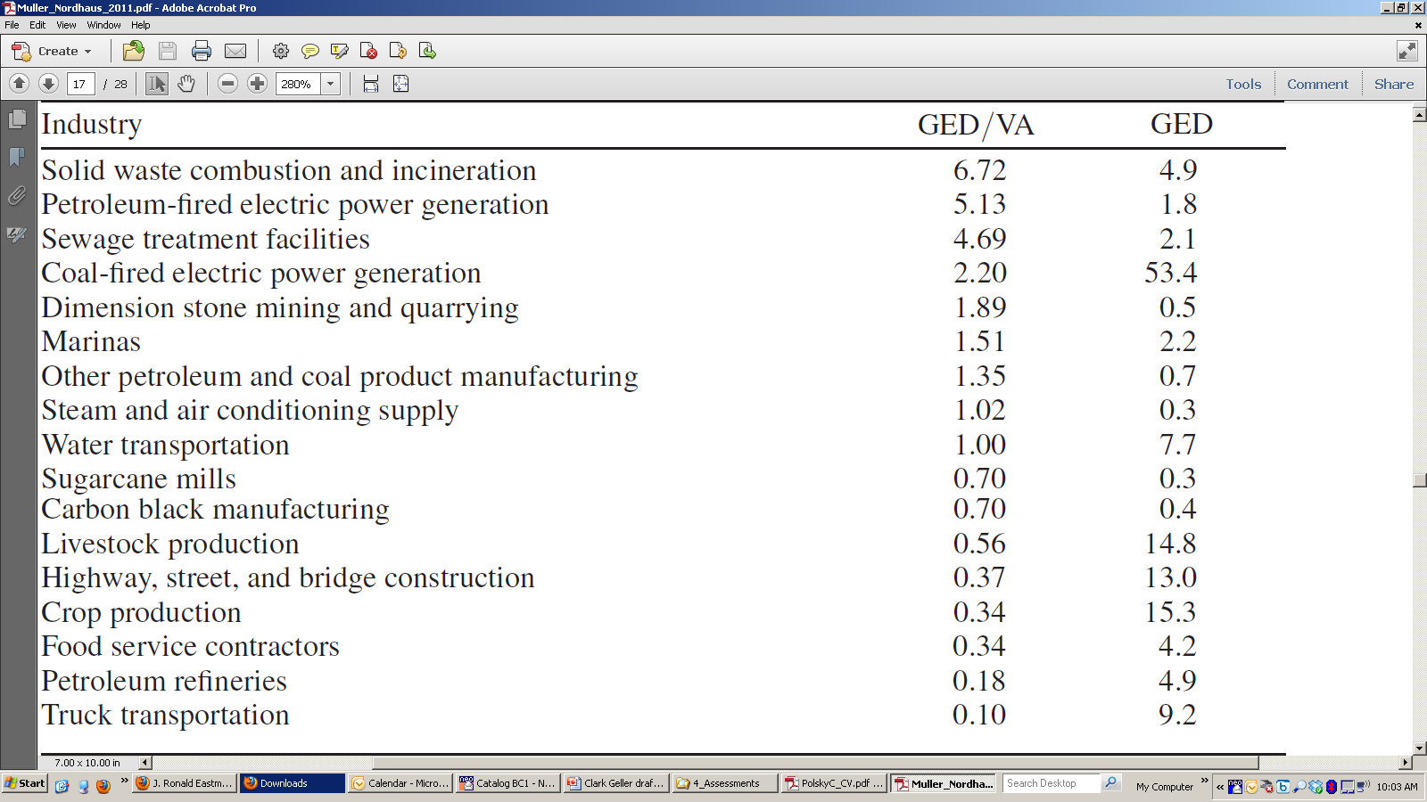
National (USA) evaluations of sectors W = f (C_{m}, C_{n}, C_{h}, [C_{s}, C_{k}])
(Muller et al, 2011)
Notes:
Muller, Nicholas Z., Robert Mendelsohn, and William Nordhaus. 2011. Environmental accounting for pollution in the united states economy. American Economic Review 101 (5): 1649-75, http://www.aeaweb.org.ezp-prod1.hul.harvard.edu/articles.php?doi=10.1257/aer.101.5.1649.

Slide 53
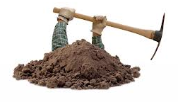
National (USA) evaluations of sectors W = f (C_{n}, C_{h}, C_{m}, C_{s}, C_{k})
(Muller et al, 2011)
Notes:
Bottom line: Using fossil fuels for electricity production (along with a few other activities) is a VERY BAD IDEA.
Muller, Nicholas Z., Robert Mendelsohn, and William Nordhaus. 2011. Environmental accounting for pollution in the united states economy. American Economic Review 101 (5): 1649-75, http://www.aeaweb.org.ezp-prod1.hul.harvard.edu/articles.php?doi=10.1257/aer.101.5.1649.

Slide 54
Comparative evaluations of W highlight Human Capital’s import
W = f (C_{n}, C_{h}, C_{m}, [C_{s}, C_{k}])
Capital Stock Estimates for China, 1995 – 2000
(in 2000 US$)
 | Natural capital | Human capital | Manuf. capital | TOTAL W
1995 capital stock | $3,200 | $1,717,900 | $3,100 | $1,724,200
Change 1995-2000 | -$200 | $9,400 | $2,000 | $11,100
Growth rate/ yr | -1.0% | +0.1% | +10.8% | +0.1%
(From Arrow et al., 2012)
Notes:
Arrow, Kenneth J., Partha Dasgupta, Lawrence H. Goulder, Kevin J. Mumford, and Kirsten Oleson. 2012. Sustainability and the measurement of wealth. Environment and Development Economics 17 (JUN): 317-53.

Slide 55
W = f (C_{n}, C_{h}, C_{m}, C_{s}, C_{k} |chance)
Constituents of Well-Being
Goals of SD (ends)
*material Needs
*human Capabilities
*flourishing Nature
Consumption Processes
Agents of Action (agitators)
Goods & Services
f
Production Processes
Determinants of Well-being
Human capital (C_{h})
Natural capital (C_{n})
Manufactured capital (C_{m})
Knowledge capital (C_{k})
Social capital (C_{s})
Productive Base (assets/means)

Slide 56
Grand Challenges of
Sustainability Science
A) Normative challenges
  How should values inform sustainability science?
B) Analytic challenges
  How do the workings of human-environment systems affect sustainable development (inclusive well-being)?
C) Operational challenges
  What kinds of methods, models and data are needed to do sustainability science better?
D) Strategic challenges
  What does sustainability science say about which actions can best promote sustainable development?
Notes:
Broad scope for exciting work of transcendent importance for the future of the Earth we continue to transform…. But also for the future of us.

Slide 57

Interdisciplinary work to understand the elephant of sustainable development is as exciting as it gets…

Slide 58
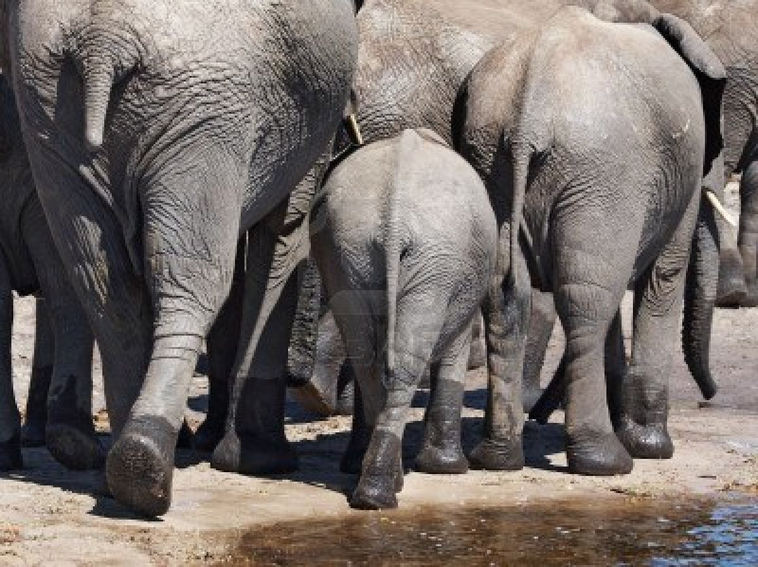
But using that understanding to help guide the herd is the ultimate grand challenge of sustainability science

Slide 59
Grand Challenges of Sustainability Science: Further Information
Sustainability Science Program @ Harvard (This presentation and related materials )
  www.hks.harvard.edu/centers/mrcbg/programs/sustsci
Reader in Sustainability Science (key papers, edited by Robert Kates)
  http://www.hks.harvard.edu/centers/cid/publications/faculty-working-papers/cid-working-paper-no.-213
PNAS Sustainability Science (current research results)
  http://sustainability.pnas.org/
Annual Review of Environment and Resources (reviews of core topics in sustainability science)
  http://arjournals.annualreviews.org/loi/energy
[Publications used for this presentation are cited in the notes to this slide]
Notes:
Selected references drawn on for this presentation
Arrow, Kenneth J., Partha Dasgupta, Lawrence H. Goulder, Kevin J. Mumford, and Kirsten Oleson. 2012. Sustainability and the measurement of wealth. Environment and Development Economics 17 (JUN): 317-53.
Beddington, John. 2009. Food, energy, water and the climate: A perfect storm of global events?
. London: Government Office for Science; UK Department of Business, Innovation and Skills, , http://www.bis.gov.uk/assets/bispartners/goscience/docs/p/perfect-storm-paper.pdf.
Bettencourt, Luís M. A., and Jasleen Kaur. 2011. Evolution and structure of sustainability science. Proceedings of the National Academy of Sciences 108 (49) (December 06): 19540-5.
Ferraro, Paul J., Merlin M. Hanauer, and Katharine R. E. Sims. 2011. Conditions associated with protected area success in conservation and poverty reduction. Proceedings of the National Academy of Sciences 108 (34) (August 23): 13913-8.
Matson, Pamela, ed. 2012. Seeds of sustainablility : Lessons from the birthplace of the green revolution. Washington, DC: Island Press, http://hollis.harvard.edu/?itemid=%7Clibrary/m/aleph%7C013104912.
Muller, Nicholas Z., Robert Mendelsohn, and William Nordhaus. 2011. Environmental accounting for pollution in the united states economy. American Economic Review 101 (5): 1649-75, http://www.aeaweb.org.ezp-prod1.hul.harvard.edu/articles.php?doi=10.1257/aer.101.5.1649.
Polasky, Stephen, Erik Nelson, Jeff Camm, Blair Csuti, Paul Fackler, Eric Lonsdorf, Claire Montgomery, et al. 2008. Where to put things? spatial land management to sustain biodiversity and economic returns. Biological Conservation 141 (6) (JUN): 1505-24.
Turner, B. L., Roger E. Kasperson, Pamela A. Matson, James J. McCarthy, Robert W. Corell, Lindsey Christensen, Noelle Eckley, et al. 2003. A framework for vulnerability analysis in sustainability science. Proceedings of the National Academy of Sciences of the United States of America 100 (14) (July 8): 8074-9.
Turner, B. L., Pamela A. Matson, James J. McCarthy, Robert W. Corell, Lindsey Christensen, Noelle Eckley, Grete K. Hovelsrud-Broda, et al. 2003. Illustrating the coupled human–environment system for vulnerability analysis: Three case studies. Proceedings of the National Academy of Sciences of the United States of America 100 (14) (July 8): 8080-5.
United Nations University International Human Dimensions Programme on Global,Environmenatal Change. 2012. Inclusive wealth report 2012 : Measuring progress toward sustainability. Cambridge: Cambridge University Press, http://hollis.harvard.edu/?itemid=%7Clibrary/m/aleph%7C013346550 (accessed 1/23/2013 8:00:53 PM).

